Slide 1
Extensions
Name
Institution
Date

Slide 2
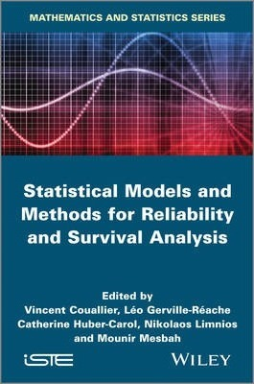
Survival Analysis Models
Involves the use of time-dependent covariates
Time-dependent covariates include alcohol consumption during pregnancy
May also include time-independent predictors
Time-independent predictors include race and sex (Austin, 2017).
Notes:
One of the approaches used in the analysis of the impact of multiple risk factors is the survival analysis model. The components of survival analysis models include time-dependent and time-independent predictors. Time-dependent predictors include nicotine and alcohol during pregnancy. Notably, the drinking of alcohol and smoking of cigarettes may change within the course of a pregnancy. However, the inclusion of time-dependent covariates in the survival analysis models may have several challenges. One of these challenges is inappropriate data management as well as measurement (Austin, 2017). The use of statistical computing packages, such as the statistical analysis system, makes it easy to include time-dependent covariates in survival analysis models.

Slide 3
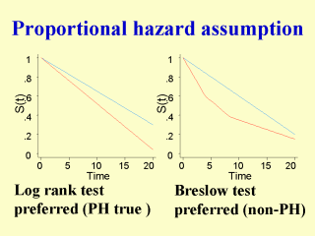
Proportionality Assumption
Holds that hazards are proportional within a given time range
This implies that the impact of a risk factor does not change over time
Uses statistical tests and graphical assessments
In statistical testing, a timing predictor is included and tested (Emmert-Streib & Dehmer, 2019).
Notes:
The proportionality assumption is appropriately used in the log-rank test. This assumption holds that hazards are proportional within a given time range, and the implication of this is that the impact of a risk factor does not change over time. The proportionality assumption uses statistical tests and graphical analysis. In statistical testing, a timing predictor is included and tested to determine its statistical importance. If at least one of the time predictor interactions reaches statistical importance of, say, p<0.05, it implies that there is a violation of the proportionality assumption (Emmert-Streib & Dehmer, 2019). Graphical assessments are based on the examination or lack of trends over time. If either the graphical or statistical assessment implies a lack of proportionality of hazards within a given time range, the Cox proportional hazard model is unsuitable, and changes are required to justify non-proportionality.

Slide 4
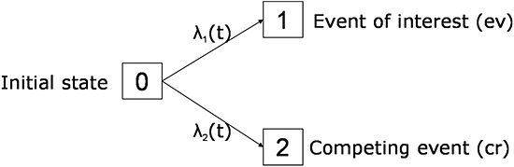
Competing Risks
This is where there is a possibility of several outcome events that cause a conflict of interest.
The objective is to identify the risk factors for every outcome
Investigators are interested in determining if the outcome occurs within the period of observation (Lee et al., 2018).
Notes:
Competing risk is where there is a possibility of several outcome events that may result in a conflict of interest (Lee et al., 2018). For example, when investigating the death on kidney dialysis, providing a kidney transplant to a patient is an event that causes a conflict of interest to the interest of the event, which is death. The objective of analyzing competing risks is to identify the risk factors for every outcome event. Investigators In competing risks are interested in determining if the outcome occurred within the given period of observation. In addition, investigators may be interested in determining the time it takes for each different event to occur.

Slide 5
References
Austin, P. C. (2017). A tutorial on multilevel survival analysis: methods, models, and applications. International Statistical Review, 85(2), 185-203.
Emmert-Streib, F., & Dehmer, M. (2019). Introduction to survival analysis in practice. Machine Learning and Knowledge Extraction, 1(3), 1013-1038.
Lee, C., Zame, W., Yoon, J., & van der Schaar, M. (2018, April). Deephit: A deep learning approach to survival analysis with competing risks. In Proceedings of the AAAI Conference on Artificial Intelligence (Vol. 32, No. 1).

